Slide 1


PROJECT ZOMBIA
Jagan Mohan Reddy Dwarampudi
E18CSE070

Slide 2


EXECUTIVE SUMMARY
You play as a lone survivor of a zombie apocalypse in a city block that is isolated from the outside world to protect against the wandering zombies, but the zombies have found their way into the city, and you must use your skills and your arsenal of the last remaining rifle to defend against them while they keep trying to kill you.

Slide 3

MAIN GAME VIEW
Classic endless runner genre in a 3D open world
Set in a city block
Round dependent enemy difficulty

Slide 4
CORE PLAYER ACTIVITY
Zombies attack player
Shoot to kill zombies
Move & Jump around the map
Stay alive to get a power-up
Use zombies to your advantage

Slide 5









GAME CONTROLS
MOVE
VIEW
JUMP
SHOOT

Slide 6

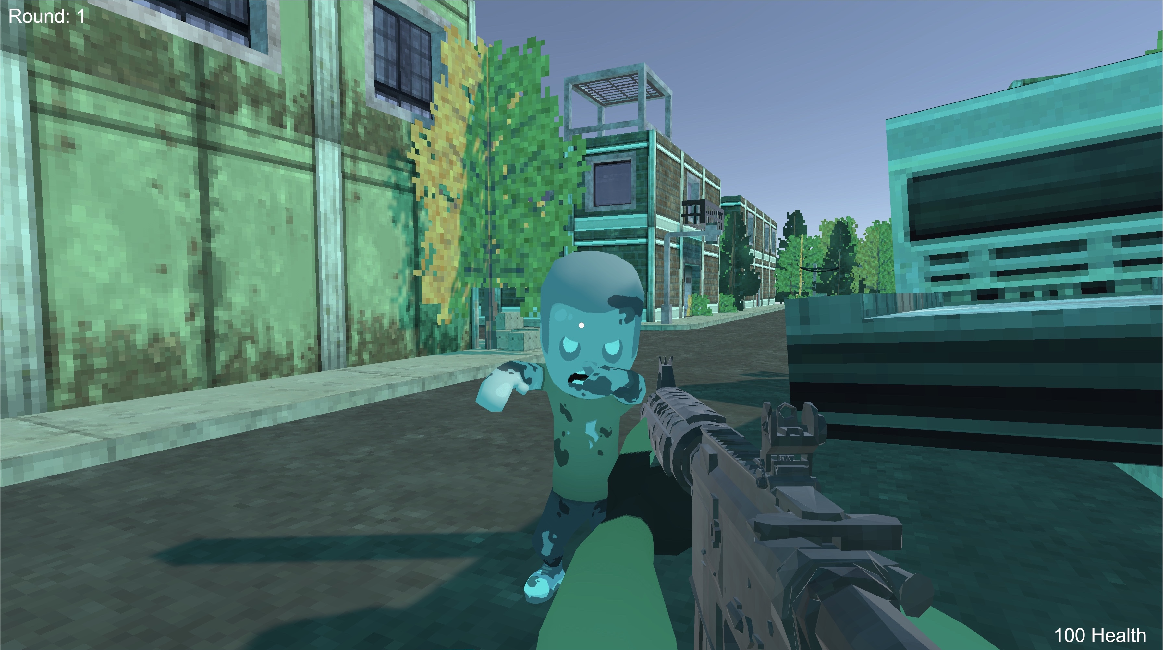
IN-GAME GUI
Bottom Right
Top Left
Player Health
Current Round

Slide 7

GAME ELEMENTS
Characters
01
Level
02
Main Menu
03
End Screen
04
Player and Zombies
Endless rounds
Title, Play, and Exit
Rounds, Play, and Menu

Slide 8

SOUND EFFECTS
PLAYER WALKING
ZOMBIE ATTACK
GUNSHOT

Slide 9
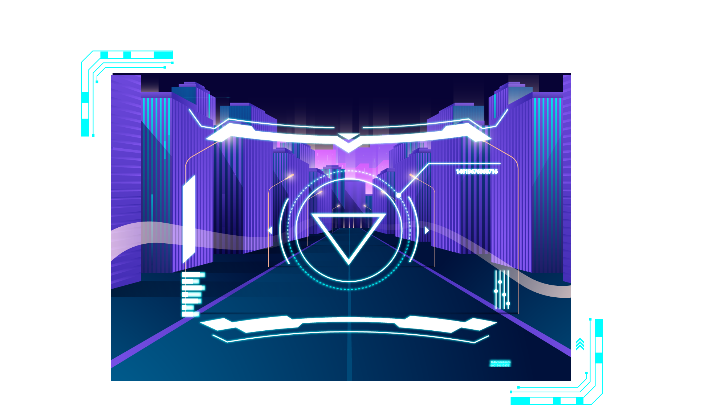

PROMO
Gameplay Promo from YouTube

Slide 10


THANK YOU
Does anyone have any questions?
jd4386@bennett.edu.in
/jd4386
@scientistjagan2000
@scientistjagan2
/jdwarampudi

